Slide 1
CSE 109 Electrical Circuits
Dr. Md. Forkan Uddin
Associate Professor
Department of Electrical and Electronic Engineering (EEE)
Bangladesh University of Engineering and Technology (BUET)

Slide 2
Parallel Circuits
Boylestad – Chapter 6

Slide 3
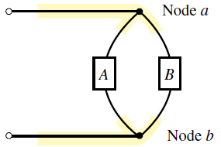
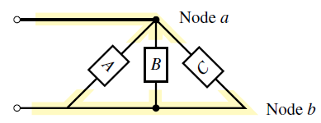
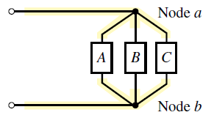
Parallel Circuits
Two elements, branches, or networks are in parallel if –
they have two points in common

Slide 4
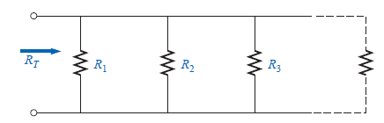
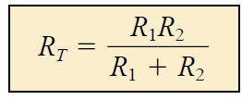


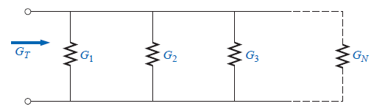

Parallel Resistance
Special Case:
1. N = 2
R_{N}
2. For R₁ = R₂ = … = R_{N} = R,
Alternatively:

Slide 5
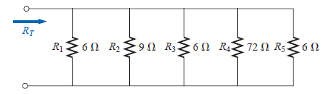
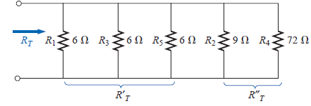

Example: Parallel Resistance
Calculate R_{T}
= 1.6 Ω

Slide 6
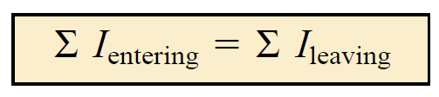
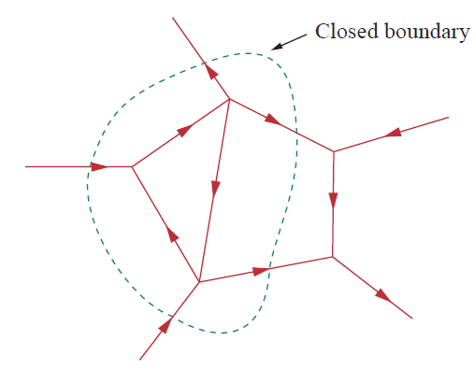
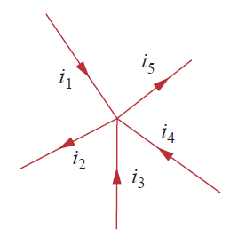
Kirchoff’s Current Law (KCL)
The algebraic sum of the currents entering and leaving an area, system, or node (junction) is zero
Incoming Current: -ve
Outgoing Current: +ve

Slide 7
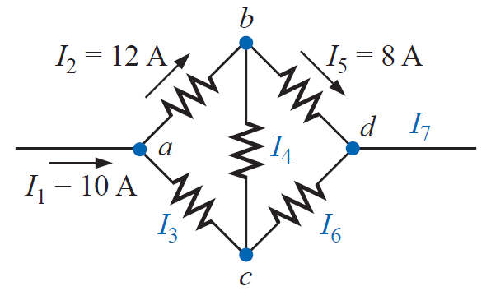
Example: KCL
Calculate the unknown currents (all currents flowing from left to right)

